Slide 1
Unit 5 Code Generation
Sini Anna Alex

Slide 2

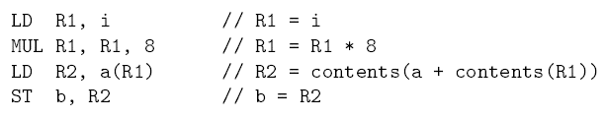
Machine Instructions for
Assume elements of a are indexed starting at 0

Slide 3
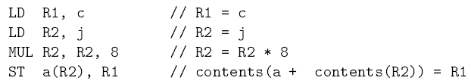
Machine Instructions for

Slide 4
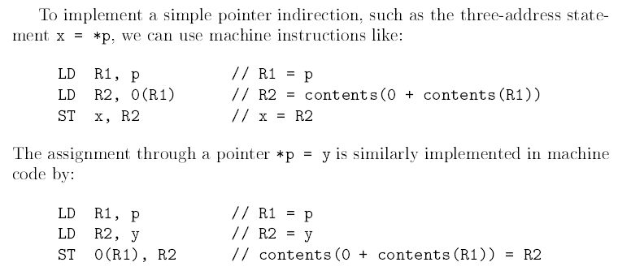
Generate Code for the three address statements

Slide 5

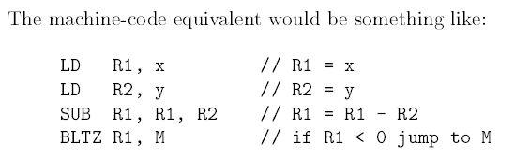
Machine code for a conditional jump instruction like
Here M means the label L

Slide 6
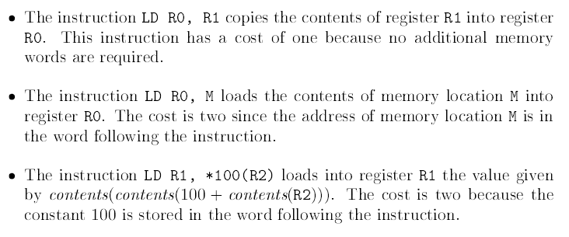
Program and Instruction Cost

Slide 7
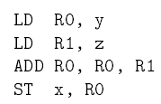
Cost :
2+2+1+2 = 7

